Slide 1
Mother-to-Child Transmission of Cytomegalovirus
This project aims to provide a framework to
deduce the possibility that the infant will be infected by CMV
help test different hypotheses of what might affect the transmission
Calibration required

Slide 2
Method Overview:
Maternal viral dynamics:
System of ordinary differential equations
Viral transmission through placenta:
(System of) partial differential equation(s) and analytic solution
Viral dynamics in infant:
Stochastic simulation

Slide 3

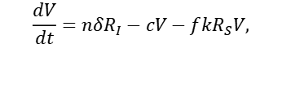
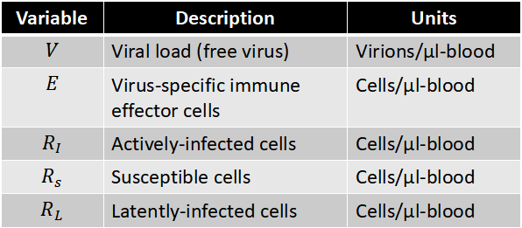









Maternal viral dynamics using ODE
$$\frac{dV}{dt}=nδR_{I}−cV−fkR_{S}V,$$
$$\frac{dE}{dt}=\left(1−ε_{S}\right)\left(λ_{E}\left(1−\frac{E}{e}\right)E+ρV\right),$$
$$R_{L}$$
$$R_{s}$$
$$\frac{dR_{I}}{dt}=kR_{S}V−δR_{I}−\left(1−ε_{S}\right)mER_{I}+α_{0}R_{L}−κ R_{I},$$
$$\frac{dR_{S}}{dt}=λ_{rep}\left(1−\frac{R_{S}}{r_{S}}\right)R_{S}−kR_{S}V,$$
$$∅$$
$$\frac{dR_{L}}{dt}=λ_{rep}\left(1−\frac{R_{L}}{r_{L}}\right)R_{S}+κ R_{I}.$$
$$R_{I}$$
$$V$$
$$∅$$
Variable | Description | Units
$$V$$ | Viral load (free virus) | Virions/μl-blood
$$E$$ | Virus-specific immune effector cells | Cells/μl-blood
$$R_{I}$$ | Actively-infected cells | Cells/μl-blood
$$R_{s}$$ | Susceptible cells | Cells/μl-blood
$$R_{L}$$ | Latently-infected cells | Cells/μl-blood
$$∅$$
$$E$$

Slide 4
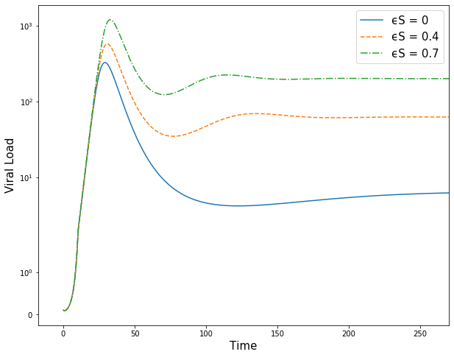
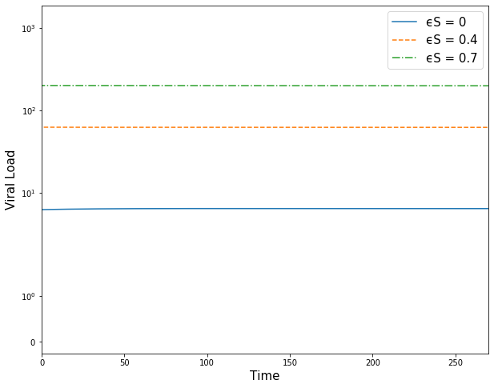
Maternal viral dynamics using ODE
$ε_{S}$: Level of immune suppression, corresponding to depletion of CD4+ level
Primary Infection of CMV
Chromic Infection of CMV

Slide 5
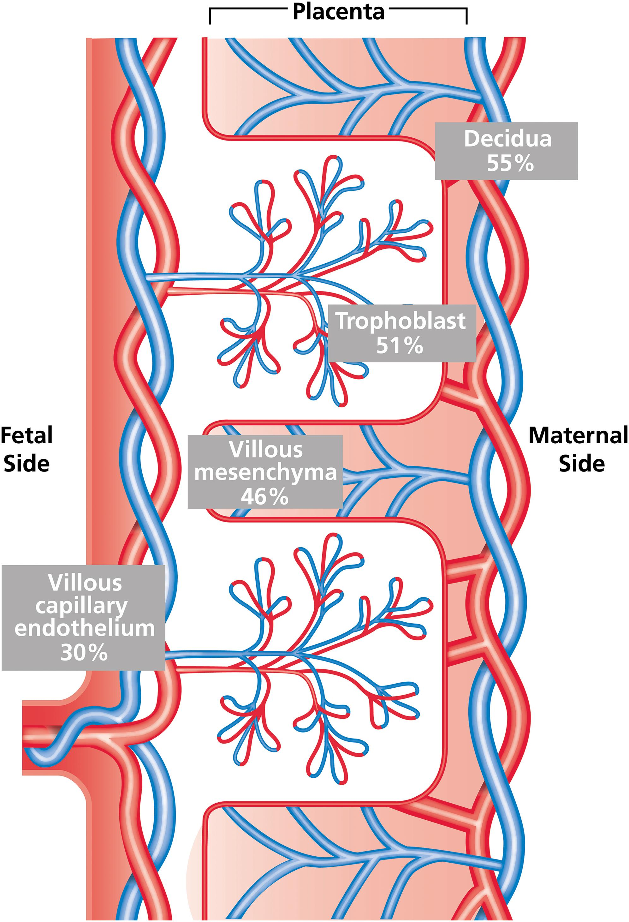



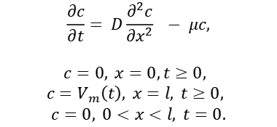
Viral Transmission through Placenta (PDE)
$c=0, 0<x<l, t=0,$ no virus inside placenta at first.
$$c=0, x=0,t≥0,$$
When virus enters the infant, it quickly gets washed away with blood.
$$c=V_{m}\left(t\right), x=l, t≥0,$$
Viral dynamics on mother side is given by the ODE system.
Spatial movement due to diffusion
$$\frac{∂c}{∂t}= D\frac{∂^{2}c}{∂x^{2}} − μc,$$
$$c=0, x=0,t≥0,$$
$$c=V_{m}\left(t\right), x=l, t≥0,$$
$$c=0, 0<x<l, t=0.$$
Clearance of CMV
$$l$$

Slide 6
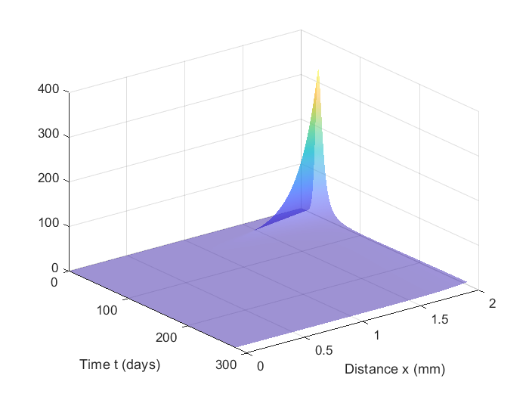
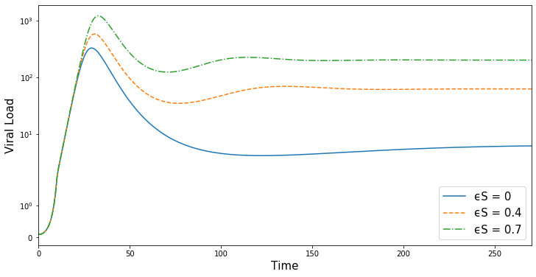


Viral Transmission through Placenta
Maternal viral dynamics using ODE
Maternal side
Boundary condition on mother side
$$\frac{∂c}{∂t}=D\frac{∂^{2}c}{∂x^{2}} −μc$$
infant side
$$l$$
Diffusion through placental transport

Slide 7
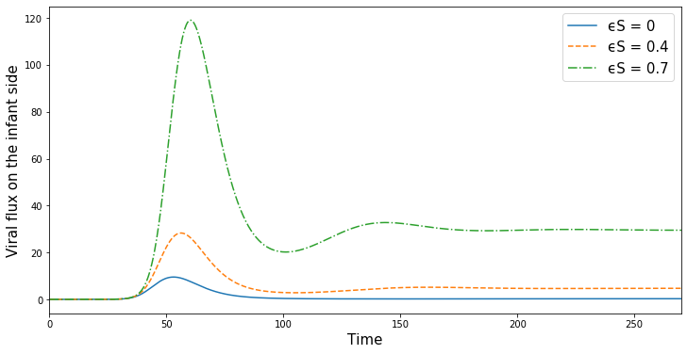
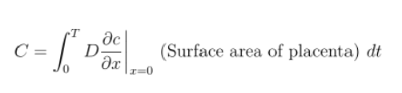
Viral Transmission through Placenta
Diffusion through placental transport
Maternal side
Zoom in on the fetal side
infant side
Number of viruses that reach the infant :
But this information is not enough.

Slide 8
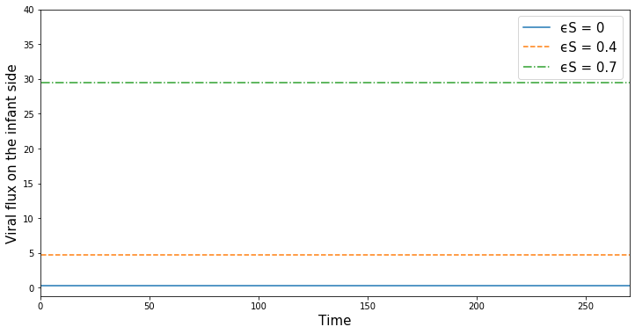
Infection of CMV
Treat the viral flux as the rate for an inhomogeneous Poisson point process, so we can obtain the time that each virus enters the infant.
Primary infection
Chronic infection
$$λ\left(t\right)=$$

Slide 9
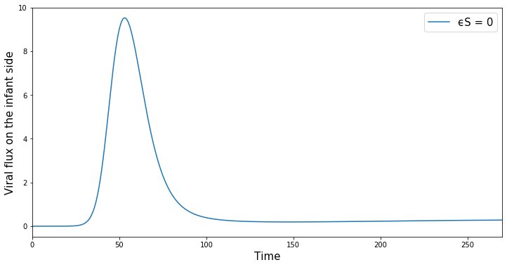
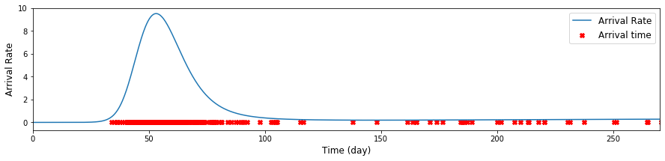
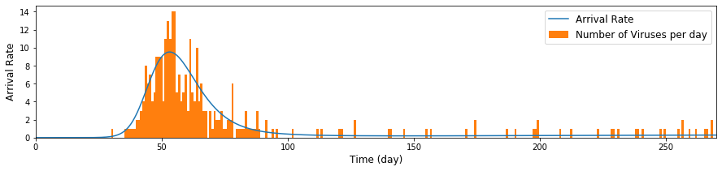
Primary Infection of CMV
Think of this flux function as probability of a virus arrives at the fetal side.
Healthy $ε_{S}$ = 0
Here we have a list of time stamp for each virus, however, just the viruses entering the infant does not mean the infant is infected.

Slide 10
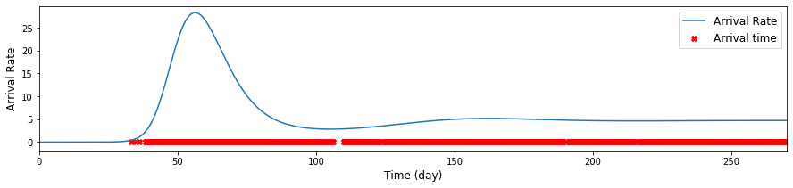
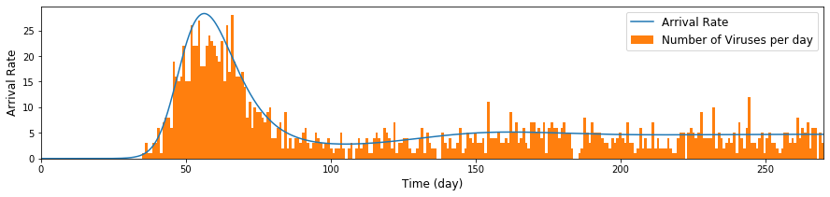
Primary Infection of CMV
Immune suppressed $ε_{S}$ = 0.4

Slide 11
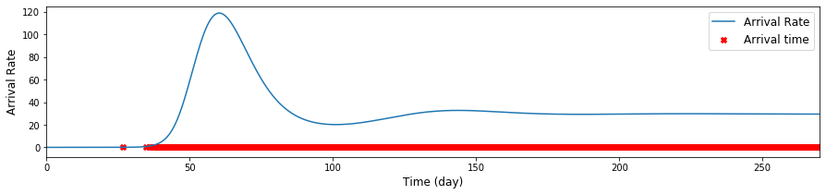
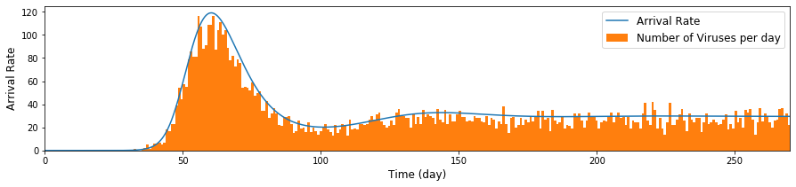
Primary Infection of CMV
Immune suppressed $ε_{S}$ = 0.7

Slide 12
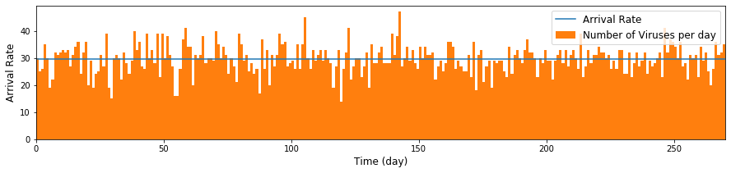
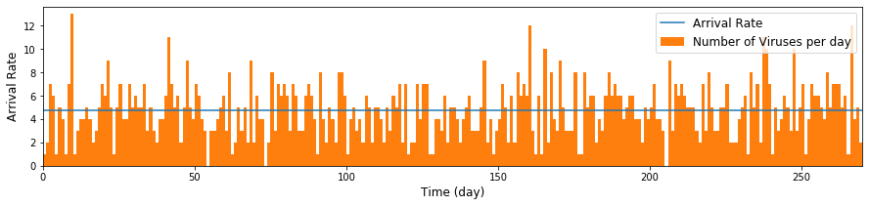
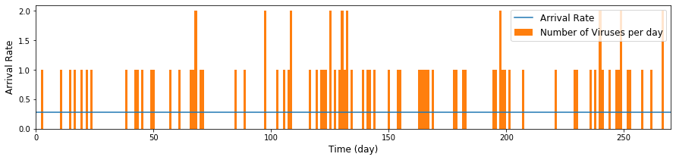
Chronic Infection of CMV
Immune suppressed $ε_{S}$ = 0.7
Chronic infection
Immune suppressed $ε_{S}$ = 0.4
Healthy $ε_{S}$ = 0
# of viruses entered | Healthy $ε_{S}$ = 0 | Immune suppressed $ε_{S}$ = 0.4 | Immune suppressed $ε_{S}$ = 0.7
Primary | $$\sim 300$$ | $$\sim 1600$$ | $$\sim 8700$$
Chronic | $$\sim 100$$ | $$\sim 1300$$ | $$\sim 8100$$

Slide 13

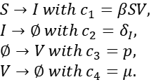



Stochastic simulation on the infant side
When the number of viruses is very small, it is possible that the viruses go extinct before causing persistent infection.
$$L$$
$$S$$
$$R_{0}=\frac{βS_{0}p}{cδ\left(1+\frac{μ}{α}\right)}≈1.36$$
$$∅$$
$$I$$
$$V$$
$$∅$$
$S→I with c_{1}=βSV,$
$I→∅ with c_{2}=δ_{I},$
$∅→V with c_{3}=p,$
$V→∅ with c_{4}=μ.$
$$∅$$

Slide 14
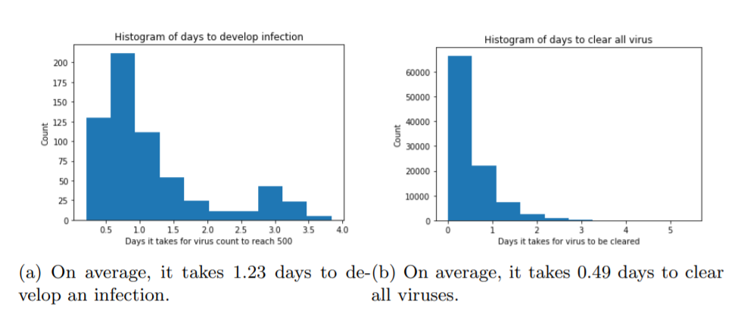
Probability of infection
Heuristic
$$\left(\frac{βSV}{βSV+μV}\right){\left(\frac{pI}{pI+δ_{I}I}\right)}^{N}≈\left(\frac{0.0012}{0.0012+1.5}\right){\left(\frac{1400}{1400+0.77}\right)}^{1000}=0.00046$$
$$Probability of infection=1−{(1−0.046\%)}^{M}$$

Slide 15
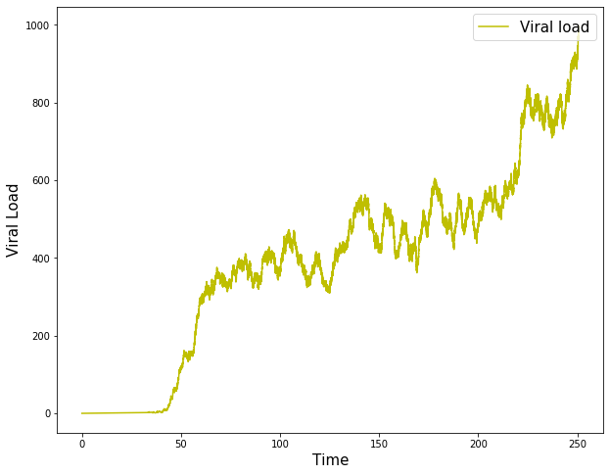
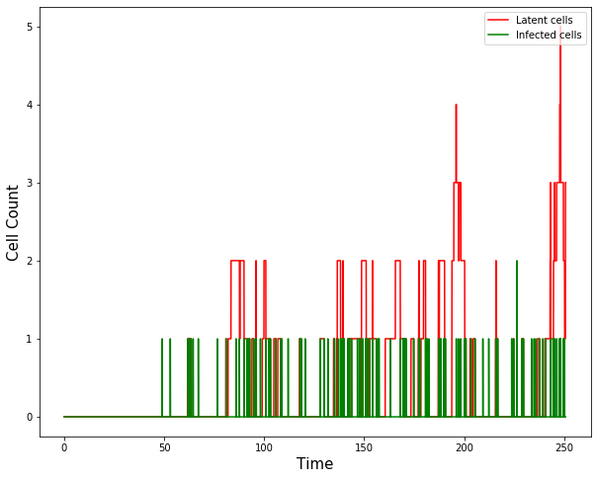
Persistent infection

Slide 16
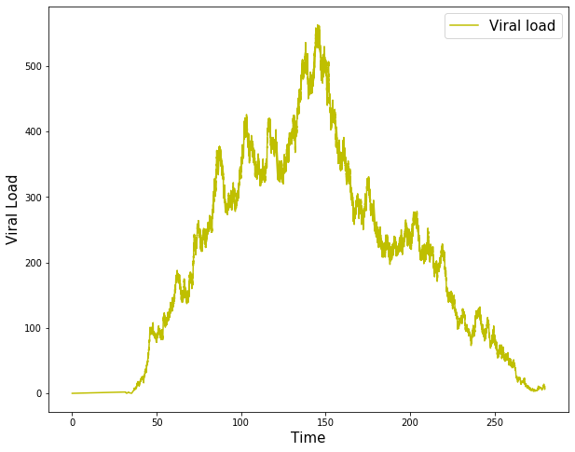
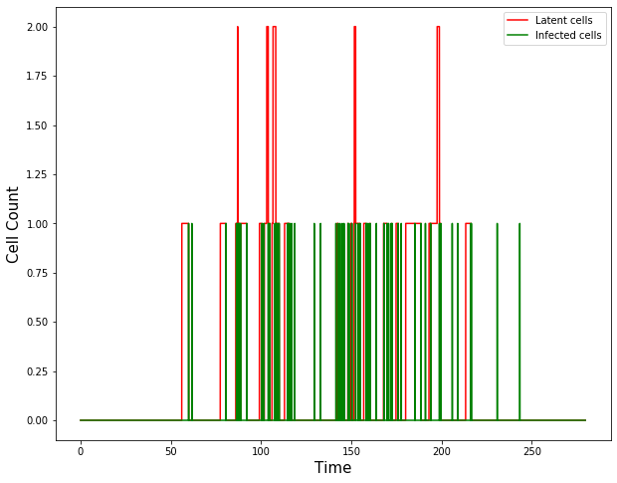
Infection that got cleared

Slide 17
Summary
This model can predict infections in two situations
Primary vs chronic
Different level of immune suppression
# of viruses entered | Healthy $ε_{S}$ = 0 | Immune suppressed $ε_{S}$ = 0.4 | Immune suppressed $ε_{S}$ = 0.7
Primary | $$\sim 300$$ | $$\sim 1600$$ | $$\sim 8700$$
Chronic | $$\sim 100$$ | $$\sim 1300$$ | $$\sim 8100$$
Infection rate | Healthy $ε_{S}$ = 0 | Immune suppressed $ε_{S}$ = 0.4 | Immune suppressed $ε_{S}$ = 0.7
Primary | $12.89\%$ | $$52.19\%$$ | $$98.17\%$$
Chronic | $$4.5\%$$ | $$45.02\%$$ | $$97.59\%$$

Slide 18
Maternal viral dynamics using ODE
Diffusion through placental transport
Maternal side
infant side

Slide 19
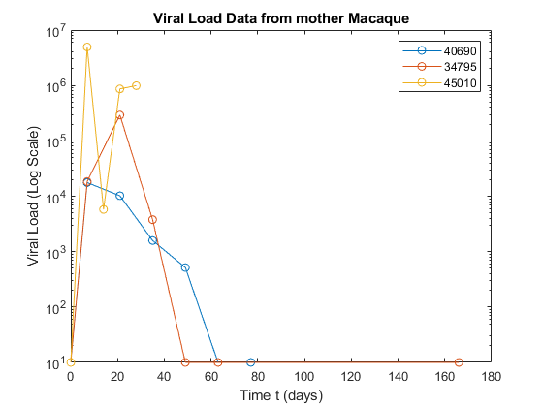
Fitting to animal data
Plasma
NX
PC-intact
RhCMV inoculation
days post rhCMV

Slide 20
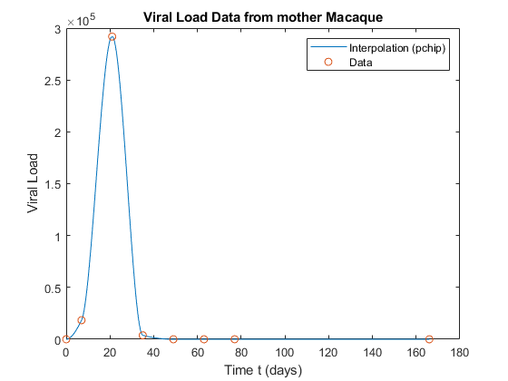
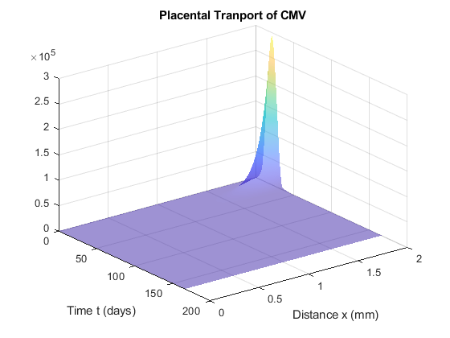
RM animal ID = 34795
Diffusion through placental transport
Maternal side
infant side
Viral clearance rate = 0.4

Slide 21
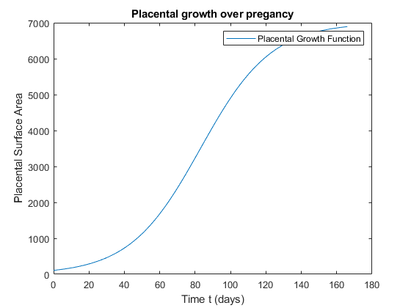
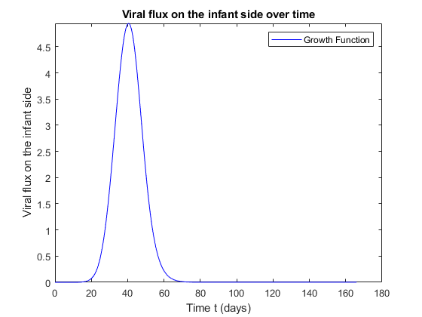
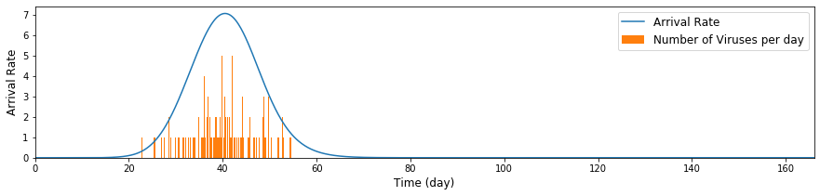




RM animal ID = 34795
$$G(t)$$
$$D\frac{∂u}{∂x}(0,t)G(t)$$
# of viruses entered$\sim 100$
$$\int_{0}^{T=166}{D\frac{∂u}{∂x}}(0,t)G(t)dt$$

Slide 22
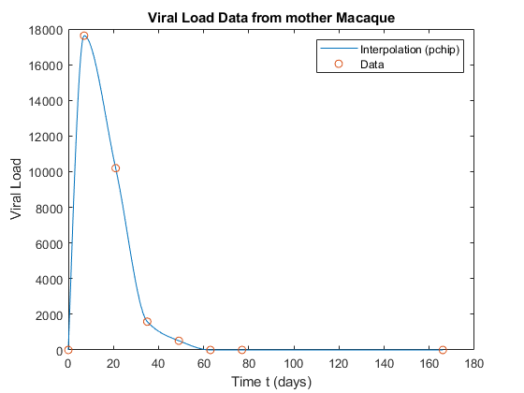
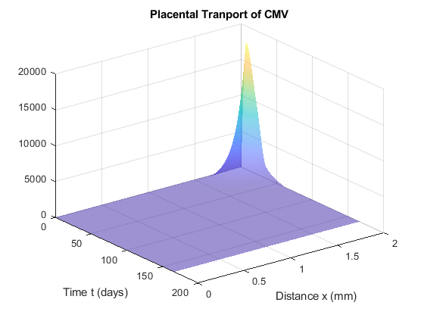
RM animal ID = 40690
Diffusion through placental transport
Maternal side
infant side
Viral clearance rate = 0.28

Slide 23
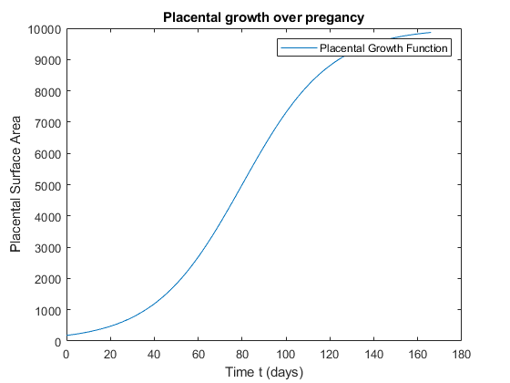
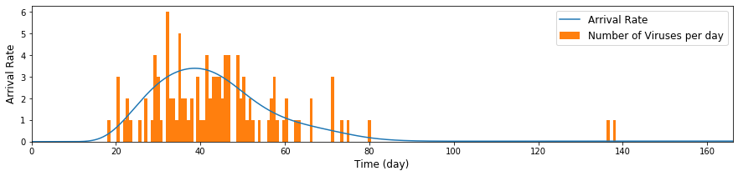
RM animal ID = 40690
$$G(t)$$
$$D\frac{∂u}{∂x}(0,t)G(t)$$
# of viruses entered$\sim 100$
$$\int_{0}^{T=166}{D\frac{∂u}{∂x}}(0,t)G(t)dt$$

Slide 24
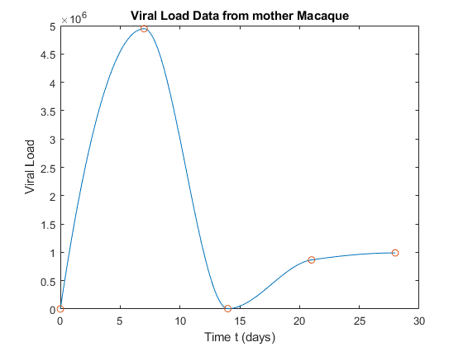
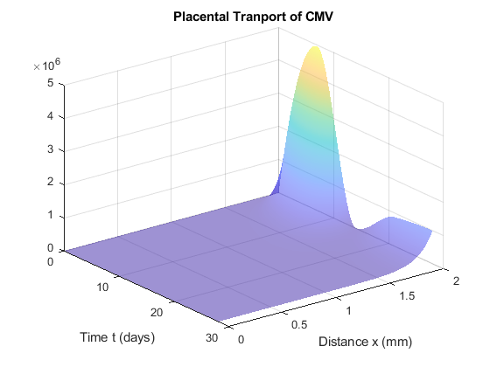
RM animal ID = 45010
Diffusion through placental transport
Maternal side
infant side
Viral clearance rate = 0.4

Slide 25
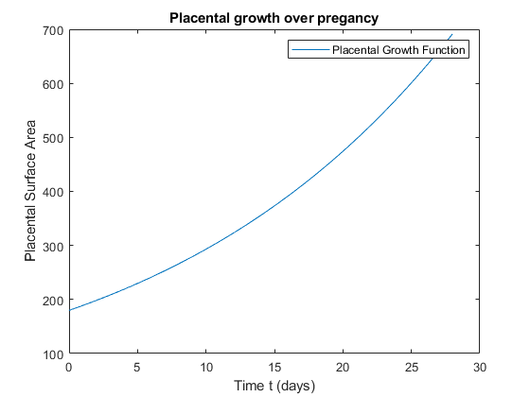
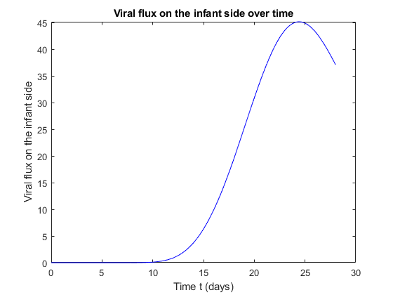
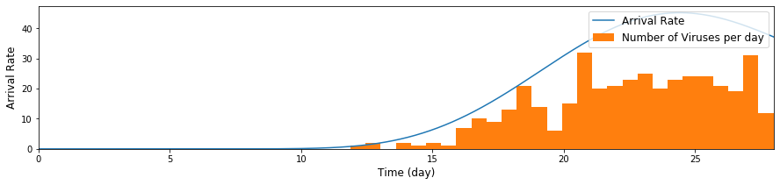


RM animal ID = 45010
$$G(t)$$
$$D\frac{∂u}{∂x}(0,t)G(t)$$
# of viruses entered$\sim 400$
$$\int_{0}^{T=28}{D\frac{∂u}{∂x}}(0,t)G(t)dt$$

Slide 26
Next step
Feedback if the model is biologically plausible
Different route of infection
Perturbation to model
Calibrate the model for human and RM data
Viral load in mother
Total number of viruses the infant
Other applicable situations for this model besides different level of immune suppression and primary vs. chronic
Adaptions to the model so that it can be applied to other viruses?
Incorporate population genomic information about CMV into the model?

